Slide 1


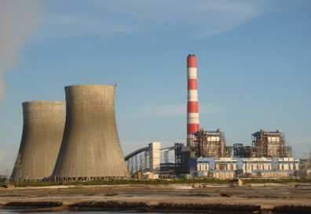
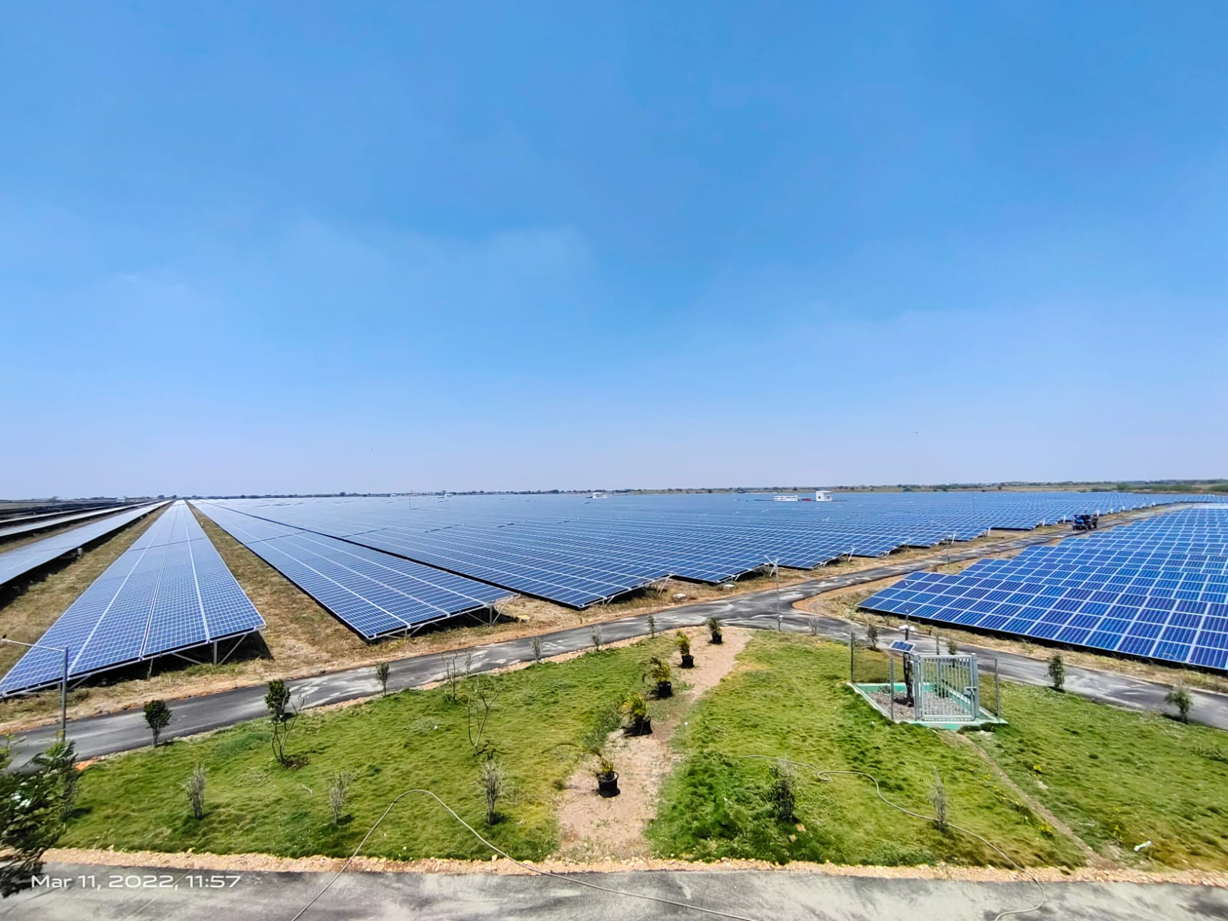


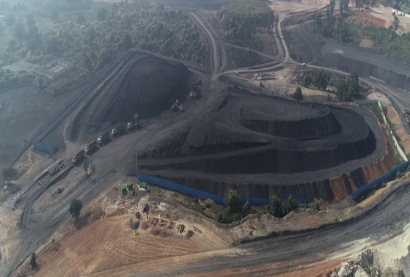

Greetings from NLC INDIA LTD
NLC India’s Comments on
Draft CERC (Terms and Conditions for Tariff determination from Renewable Energy Sources) Regulations, 2024

Slide 2
NLCIL Comments under Draft Regulation-2024
Grossing up of ROE with Effective tax rate
Compensation for Curtailment of RE Power when Normative CUF is not achieved

Slide 3
Grossing up of ROE with Effective tax rate
NLCIL Comment (Regulation 16. Return on Equity):
The rate of return on equity shall be grossed up with the effective tax rate of the company for the respective financial year in line with the Thermal Tariff Regulation.
Presently, as per the provisions of Income Tax Act 1961, the company shall pay corporate tax rate @34.944% or MAT rate @17.472% whichever is higher.
Further, Income Tax Department has introduced new provisions Section 115BAA/115BAB where companies are liable to pay only concessional corporate tax at the rates specified. MAT provision is not applicable for the company opted Section 115BAA/115BAB as the case may be.
Hence, the rate of return on equity shall be grossed up with the effective tax rate of the company for the respective financial year in line with the Thermal Tariff Regulation. In case the company is paying Minimum Alternate Tax (MAT) under Section 115JB of the Income Tax Act, 1961, the effective tax rate shall be the MAT rate, including surcharge and cess.
If generating company has opted for Section 115BAA/115BAB, the effective tax rate shall be tax rate including surcharge and cess as specified under Section 115BAA /115BAB of the Income Tax Act, 1961.

Slide 4
Compensation for Curtailment of RE Power
NLCIL Comment:
Compensation for Curtailment of RE Power shall be allowed when Generator does not have achieved Normative CUF in that particular Financial Year.
The RE tariff for Solar, Wind and other projects which adopt single part tariff structure are determined based on Normative CUF. Though accorded Must-Run status, there are instances that RE power has been curtailed which leads to under recovery due to non-achievement of normative generation, resulting in loss of revenue to the Generators.
As per clause 5.2.5 of the Gazette notification on “Flexibility Guidelines” dated 27.08.2022 by MoP, the compensation for deemed generation may be worked out as follows:
Minimum Generation Compensation = 100% of [(Average Generation per hour during the month) × (number of back down hours during the month) × PPA Tariff] Where, Average Generation per hour during the month (kWh) = Total generation in the month (kWh) ÷ Total hours of generation in the month.
Hence, it is requested to include the clause/clauses w.r.t compensation for curtailment of RE power for which the reasons are not attributable to the Generators or Power Producers.

Slide 5

Thank You

